Slide 1
Hurricane House

Slide 2
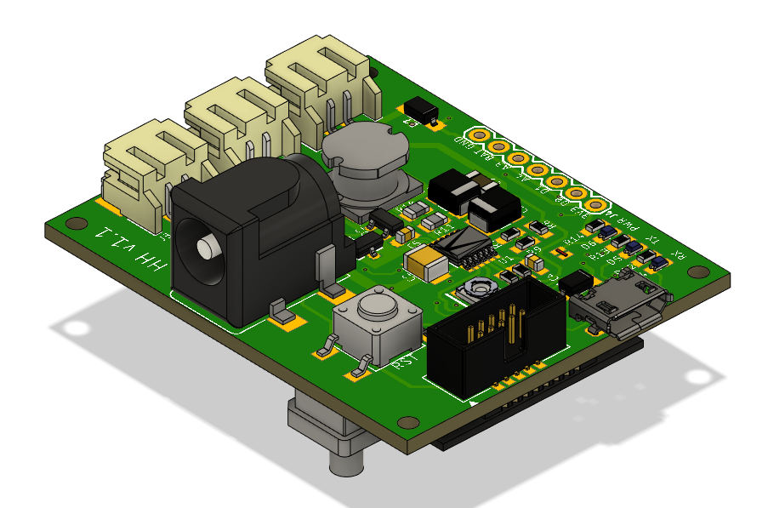
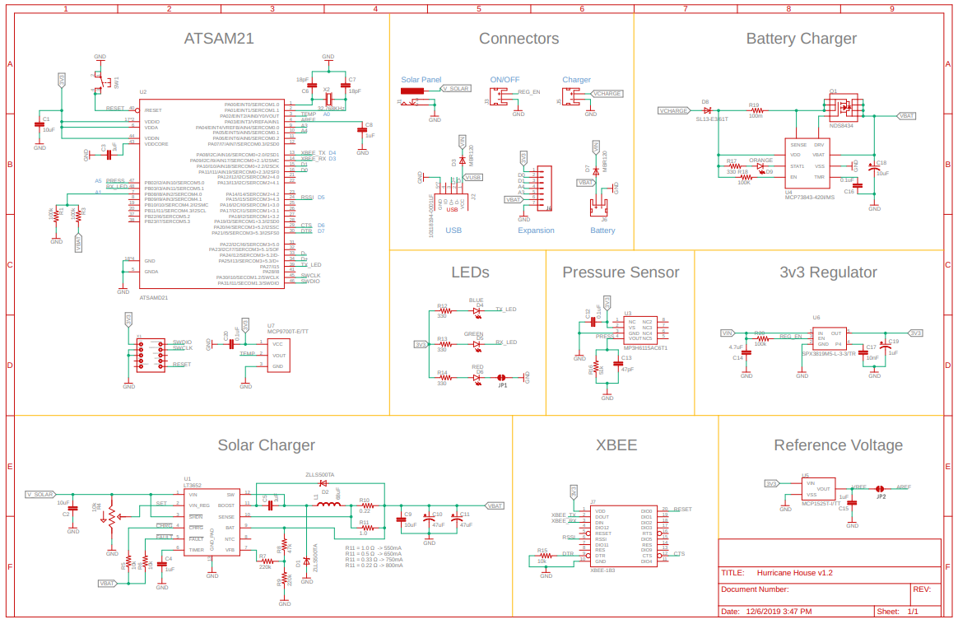
Main Board

Slide 3
Features
Main microcontroller ATSAMD21G18
Pressure sensor
Temperature sensor
XBEE
Solar charger circuit
Battery charger
External reference voltage
LEDs

Slide 4
ATSAMD21G18
32-bit Cortex-M0 + CPU running at up to 48 MHz
256 KB flash memory
32 KB SRAM memory
12-bit ADC resolution
Using Feather M0 bootloader
Running Circuit Python
Can also be programmed using Arduino
Programmed through micro USB cable

Slide 5
Pressure Sensor
MP3H6115AC6T1
Absolute pressure
Range 2.18PSI ~ 16.68PSI
Accuracy +/- 1.5%
Output voltage range 2.7V - 3.3V

Slide 6
Temperature Sensor
MCP9700T-E/TT
Temperature range -40°C ~ 125°C
Accuracy +/- 4°C (max)
Resolution 10mV/°C

Slide 7
XBEE
XB3-24Z8PT
Data rate 250 kbps
Power output 19 dBm
Sensitivity -103 dBm
1MB Flash memory
128 kB RAM memory
Indoor range 90 m
Outdoor range 3200 m

Slide 8
Solar Charger Circuit
Suited for panels that produce 6-20V output voltage
Recommended for batteries with a capacity greater than 450mAh
Charging current controlled with R11
Currently set to charge at 550 mA
Potentiometer allows to set the input current limit

Slide 9
Battery Charger
MCP73843-420I/MS
For use with battery pack voltage of 4.2 V
Max supply voltage 12 V
Min supply voltage 4.5 V
Programmable charge current resistor (R19)
Currently set to 100 mΩ

Slide 10
External Reference Voltage
MCP1525T-I/TT
Output voltage 2.5V
Tolerance 1%
Temperature drift +/- 50ppm/°C (max)

Slide 11
LEDs
Red LED indicates power
Solder pad can be cut to turn it off
Green and Blue LEDs available for general purpose

Slide 12
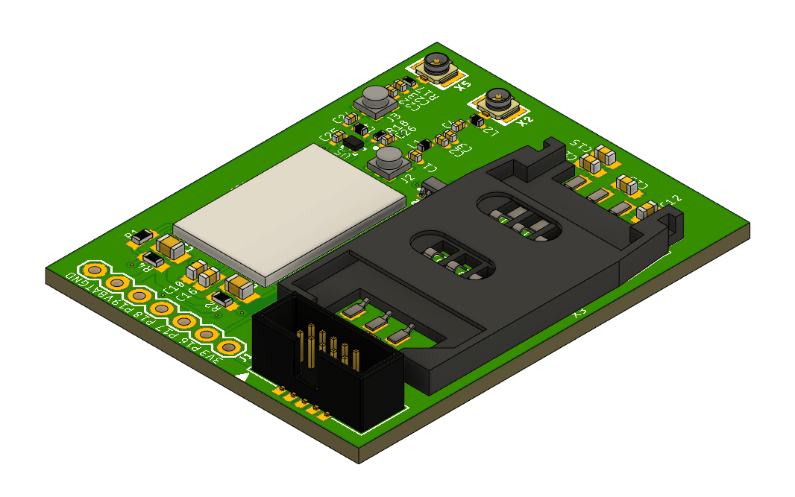
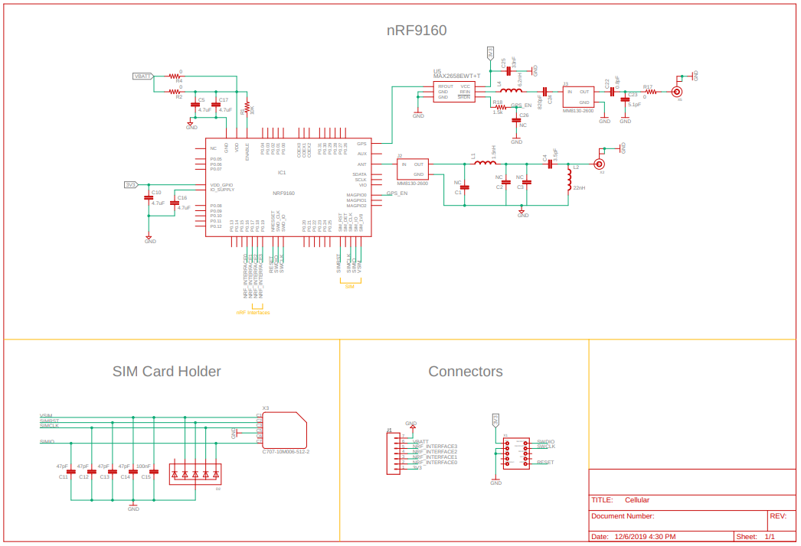
Cellular Board

Slide 13
nRF9160
Low Power SiP
Arm Cortex-M33
1 MB flash memory
256 KB RAM memory
Integrated LTE-M and NB-IoT and GPS
Supports SIM and eSIM

Slide 14
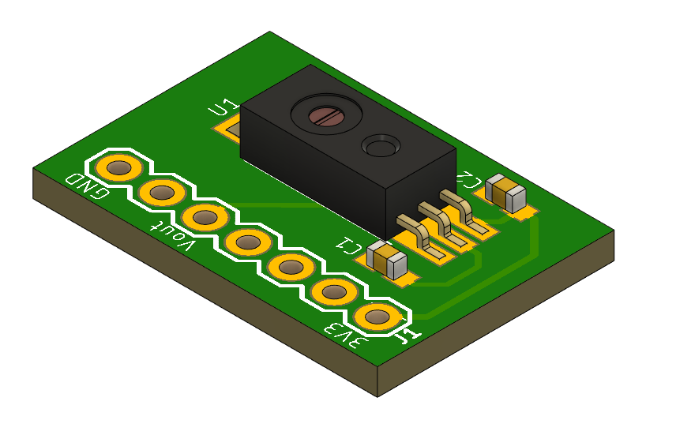
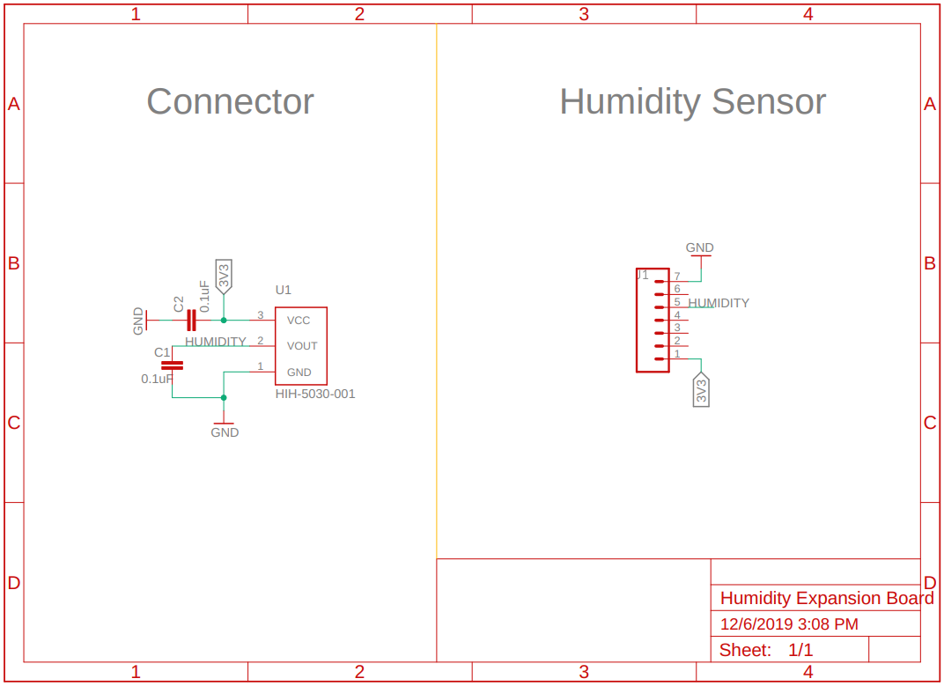
Humidity Sensor Board

Slide 15
HIH-5030-001
Humidity Range 0 ~ 100% RH
Accuracy +/- 3% RH
Response time 5s

Slide 16
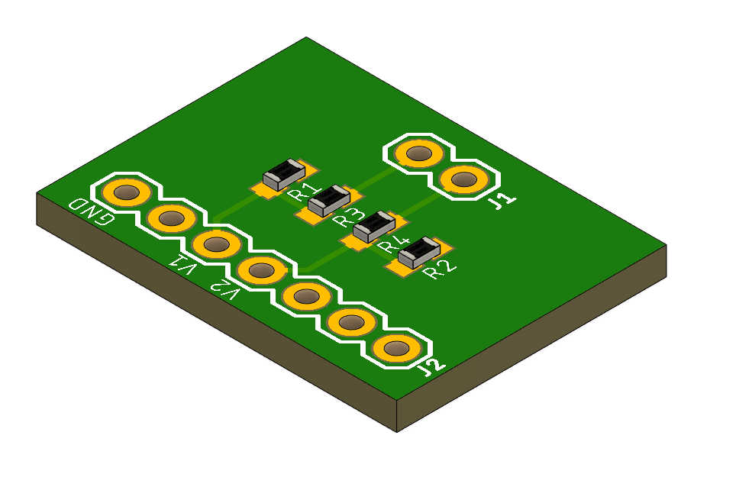
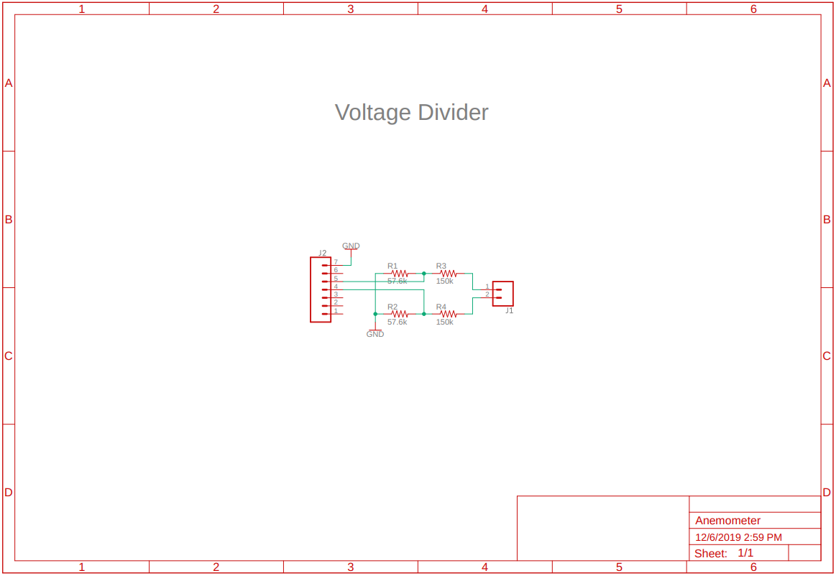
Anemometer Board

Slide 17
Voltage Divider
Maximum input voltage 12V
Maximum output voltage 3.3V

